Slide 1
Sensor Node
Hands-on Experience

Slide 2
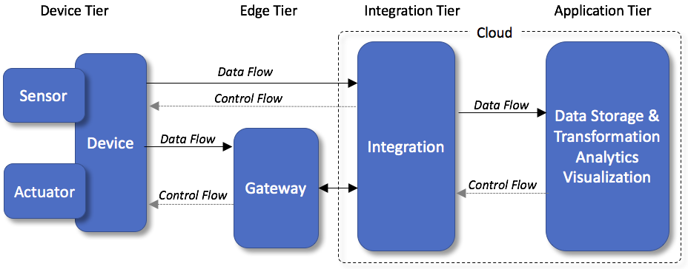
IoT building blocks

Slide 3

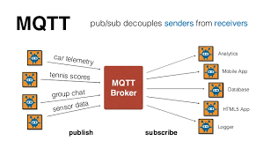
Some basics for IoT – we will use this
JSON
JSON is not a protocol, but an encoding format
Used widely in IoT
MQTT
A lightweight messaging protocol for small sensors and mobile devices, optimized for high-latency or unreliable networks
Client – Server - Client
Publish – Broker – Subscribe
Needs a Topic

Slide 4
JSON vs XML Example
JSON Example | XML
{"employees":[ { "firstName":"John", "lastName":"Doe" }, { "firstName":"Anna", "lastName":"Smith" }, { "firstName":"Peter", "lastName":"Jones" } ]} | <employees> <employee> <firstName>John</firstName> <lastName>Doe</lastName> </employee> <employee> <firstName>Anna</firstName> <lastName>Smith</lastName> </employee> <employee> <firstName>Peter</firstName> <lastName>Jones</lastName> </employee> </employees>

Slide 5
Sensor Node Source Code - sequence
Header Files Needed | Instantiation | MQTT & WiFi info | MQTT connection
#include "DHT.h" #include "WiFiEsp.h" #include <PubSubClient.h> #include <stdio.h> #include <stdlib.h> #include <string.h> #include <ArduinoJson.h> | DHT dht; WiFiEspClient client; PubSubClient mqttClient(client); | const char* server = "mqtt.dioty.co"; char ssid[] = “wifiSSID"; char pass[] = “wifiPasswd"; | if (mqttClient.connect(NULL, “user@name", “passwd")) { Serial.println("connected");
Read VCC | Read T&H | Format as JSON | Send to Cloud
averageVcc = averageVcc + (float) readVcc(); int16_t averageVccInt = round(averageVcc); dtostrf( averageVccInt, 3, 2, temp ); | dtostrf( dht.getHumidity(), 3, 2, temp2 ); dtostrf( dht.getTemperature(), 3, 2, temp3 ); | root["Voltage"] = temp; root["Humidity"] = temp2; root["Temperature"] = temp3; root.printTo(msg); | mqttClient.publish("/zaki.bm@gmail.com/1234", msg);

Slide 6
MQTT
Message Queuing Telemetry Transport is an ISO standard (ISO/IEC PRF 20922)[2] publish-subscribe-based messaging protocol.
It works on top of the TCP/IP protocol.
It is designed for connections with remote locations where a "small code footprint" is required or the network bandwidth is limited.
The publish-subscribe messaging pattern requires a message broker.
FREE, open source Mosquitto MQTT. You can install on your PC
Cloud-based MQTT broker also available, example is Dioty, HiveMQ, CloudMQTT

Slide 7
IoT Device Design – The Steps
Hardware and sensor
Make sure you can get the sensor data locally
Push the data to the cloud :
Why?.... Because we can access it anywhere
Where? …. Any cloud-based MQTT broker
Get the data and manipulate it :
How?.... Use MQTT subscriber
Manipulate?.... Yes, using tools, example is Node-Red

Slide 8
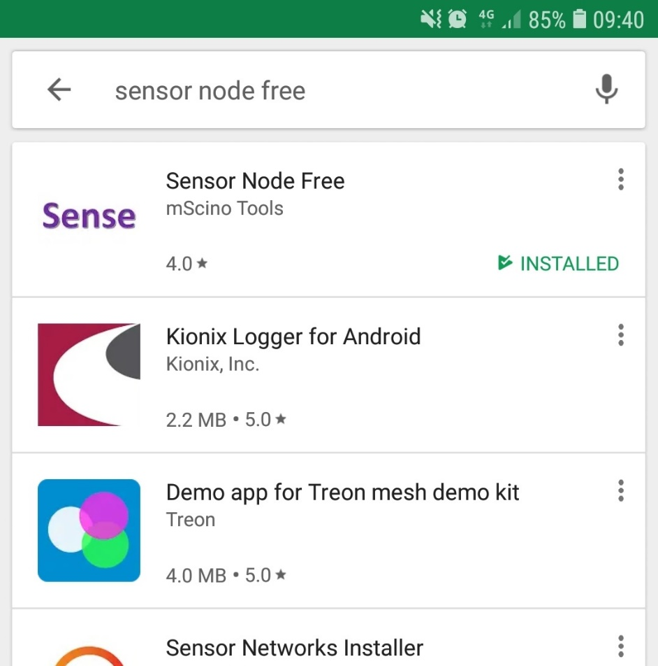
Hardware and Sensor
Our closest friend : Handphone. This App is for Android only.

Slide 9
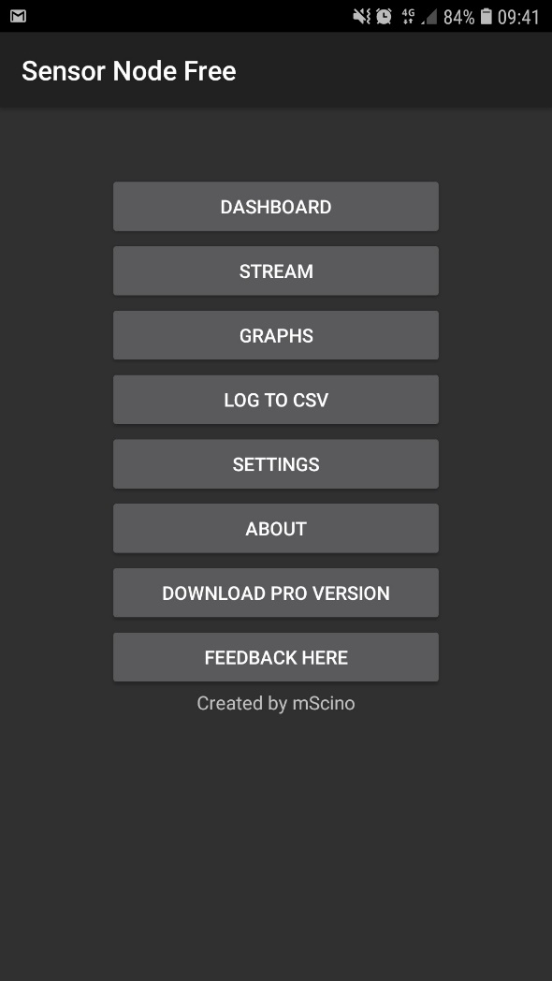
Step 1: Open the App

Slide 10
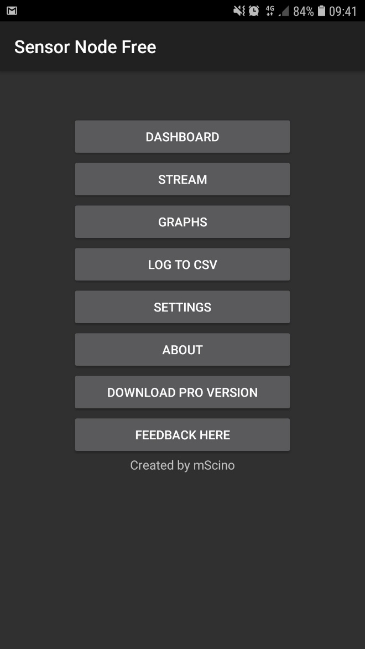
Step 2: See the dashboard

Slide 11
Make sure you can get the sensor data locally
In the dashboard, you can see all your phone’s sensors in action
It means you are now already have the sensor data…

Slide 12
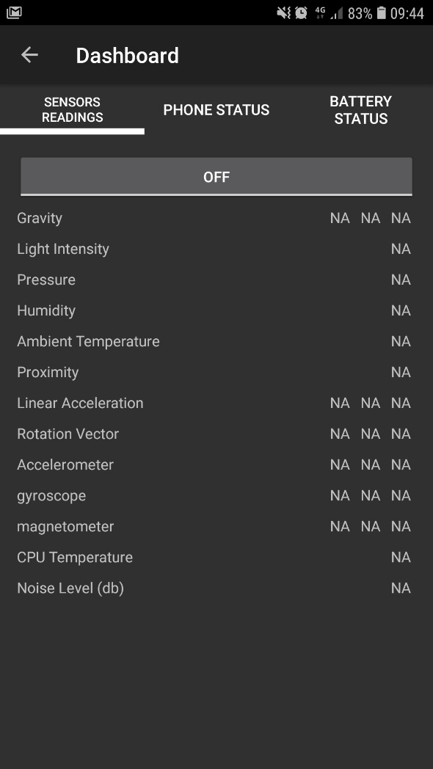
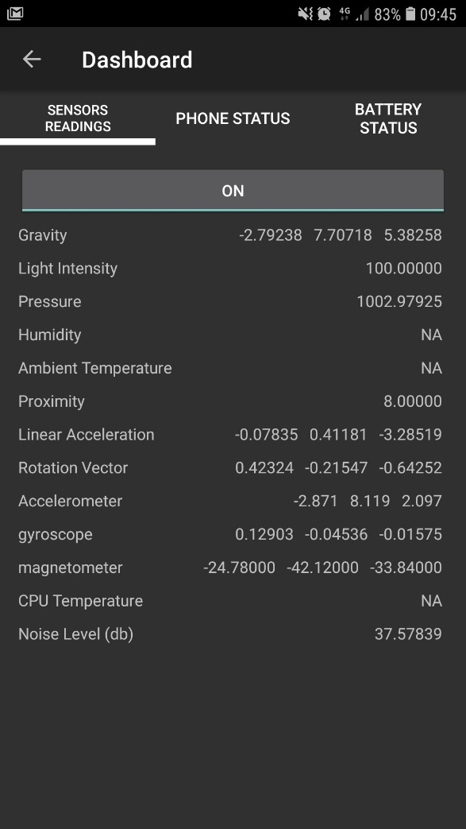
Step 2 : See the dashboard (continue)
Toggle OFF to ON

Slide 13
Push the data to cloud
Release the data
Let it go somewhere rather than just trapped inside your phone ☺
We will use MQTT service to do the work
Select any sensors you like to publish

Slide 14

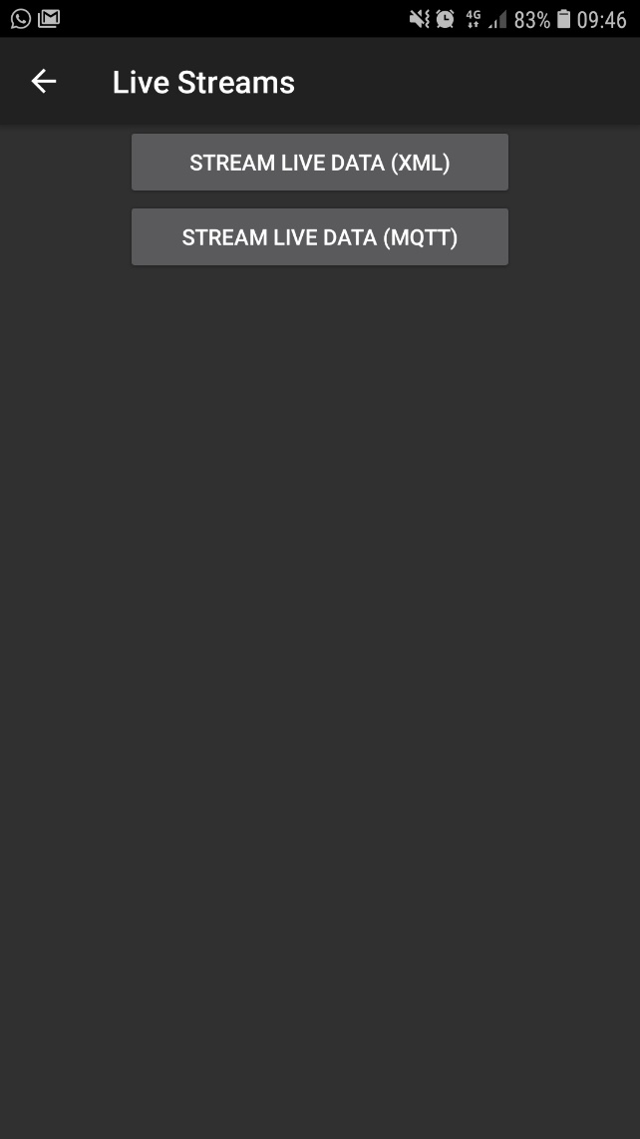
Step 3 : Stream it !
Click at “Stream”

Slide 15
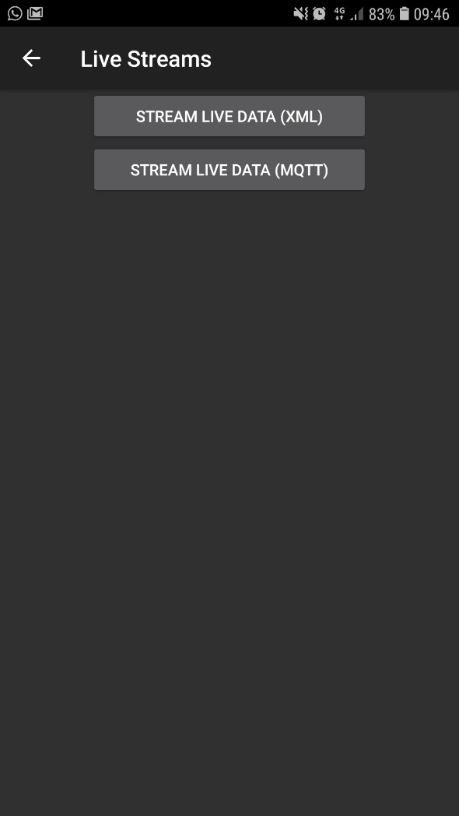
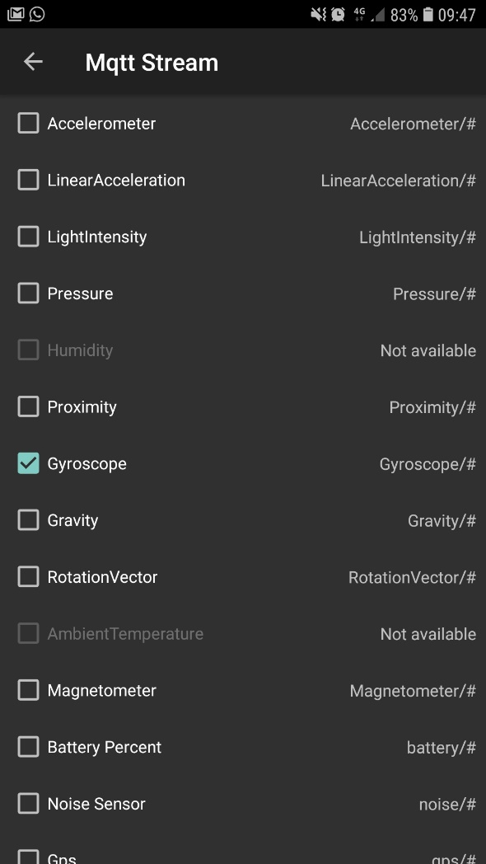
Step 3: Stream It ! (continue)
Click at MQTT stream

Slide 16
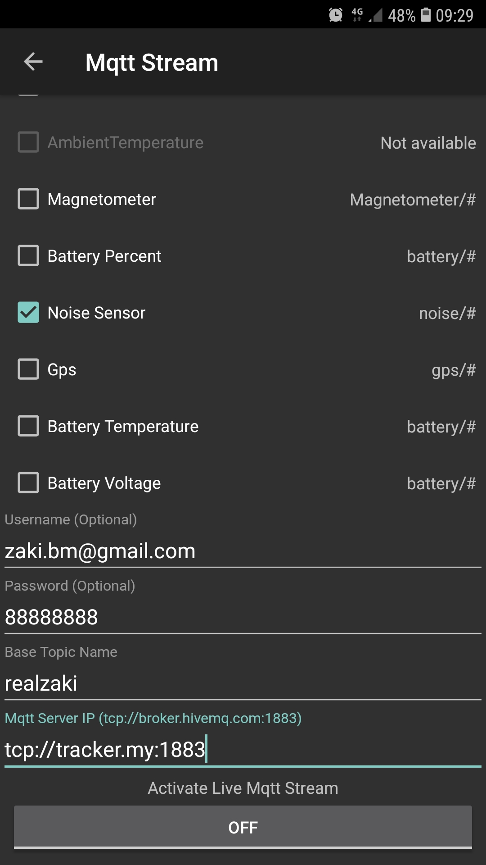
Step 4: Fill in MQTT info
Scroll down at the same screen

Slide 17
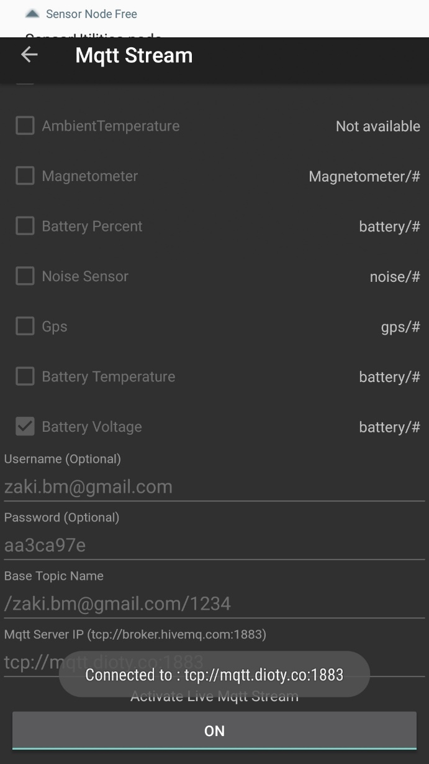
Step 4 : Press ON to publish the data
Data is now sent to DioTY MQTT broker

Slide 18
See if the data goes to Cloud Server (MQTT Broker)

Slide 19
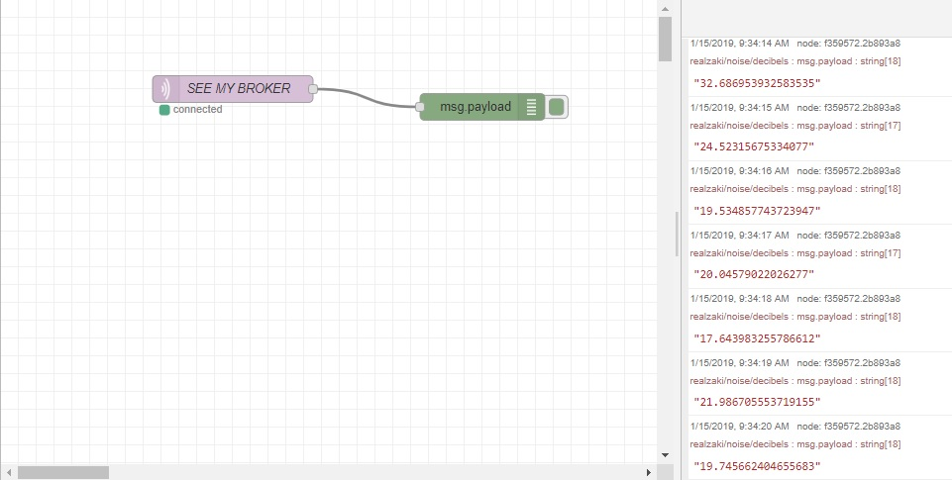
Did MQTT broker receive the data?
By right, MQTT broker received the Data we just sent.
We can check, go to your broker to see it.

Slide 20
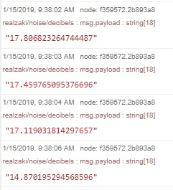
The data format sent from your phone
Base Topic
Sensor-based Topic

Slide 21
Get the data and manipulate it
Subscribe to the data
Need to use MQTT subscriber software
Once you get the data, pass it to your SW Tool.
Show chart of the data history
Automate action
Send to analytics module
Example of SW Tool to do manipulation : Node-Red (open source)

Slide 22
The Node Red Flow
Make sure you have your Node-Red running, add a New Flow
https://github.com/orenonline/LoRaWAN_WiFi_IoT_Training/
Click at “SensorNode.txt”
Click at “Raw”
Copy the whole text
Now go to your New Flow page, select Import->Clipboard
Position it nicely on the page

Slide 23
Edit FRED node
Each items in the Node-Red is called a “node”
If you do a copy and paste, all logics are copied and pasted
But credentials are not copied and pasted.
Double-click at “MyMQTT Broker” node
Click at the small pencil
Click at the Security Tab
Fill in the Username and Password.
Click “Deploy”

Slide 24
See the Debug and Dashboard
On the right hand side, click at the Debug tab
You can see the incoming data
For Dashboard, you can click at the Dashboard tab
All the dashboard item has been populated
All you need is just to press the small arrow underneath the Dashboard tab

Slide 25
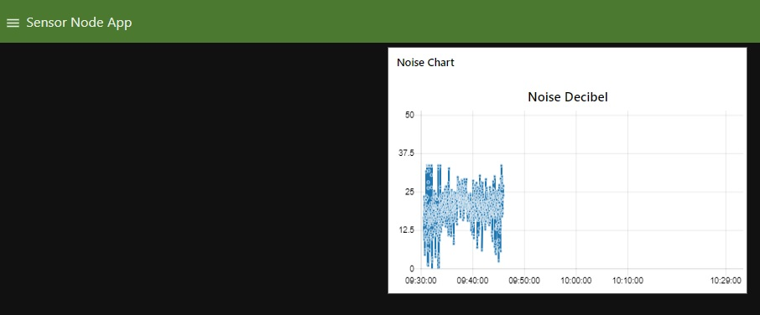
The Visualization

Slide 26
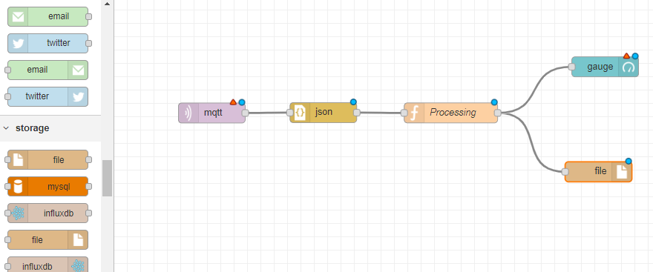
Save Data into a File

Slide 27
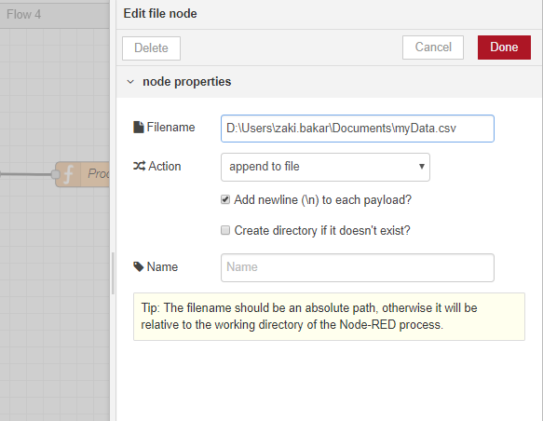
Config the File Node

Slide 28
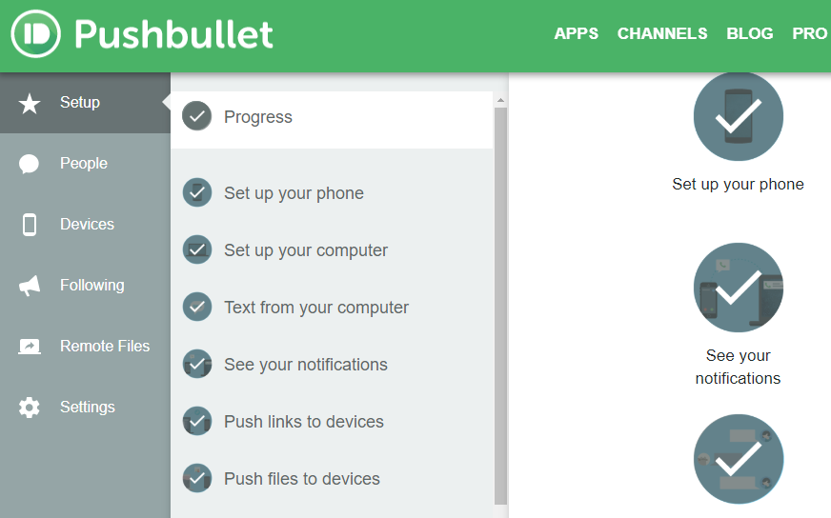
Notification to your phone
Register to Pushbullet
Install Pushbullet to your phone

Slide 29
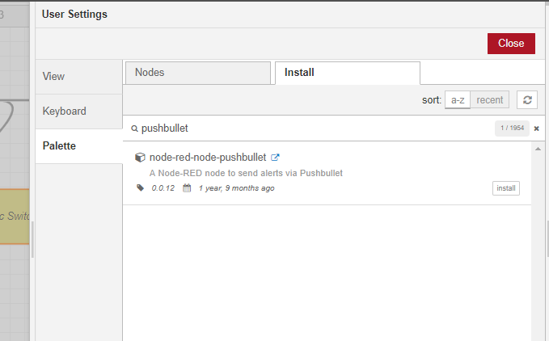
Install Pushbullet node

Slide 30
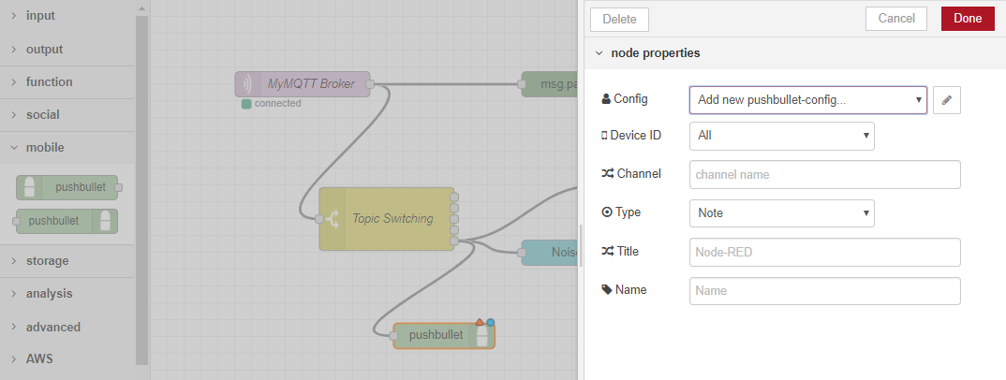
Add Pushbullet to canvas
Drag in and double-click

Slide 31
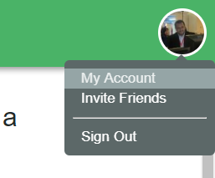
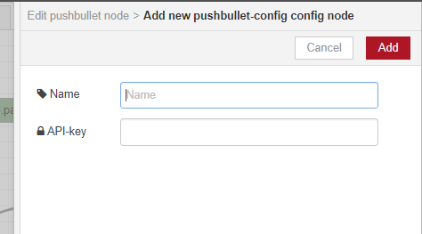
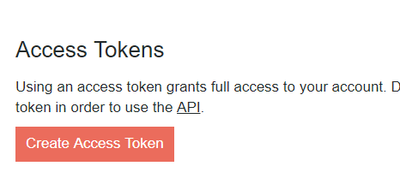
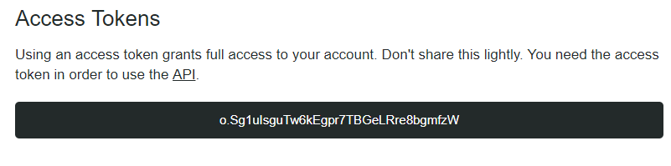
Fill up the API-key

Slide 32
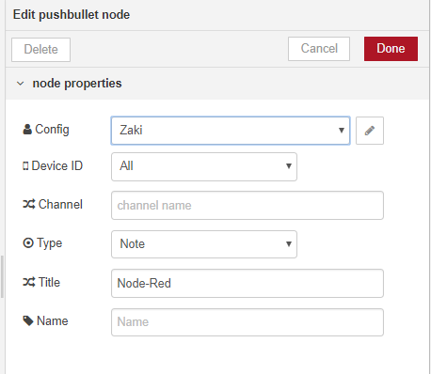
Complete the form

Slide 33
THANK YOU
Any questions?
zaki.bakar@mimos.my
nordin.ramli@mimos.my
hafizal.mohamad@mimos.my

Slide 34
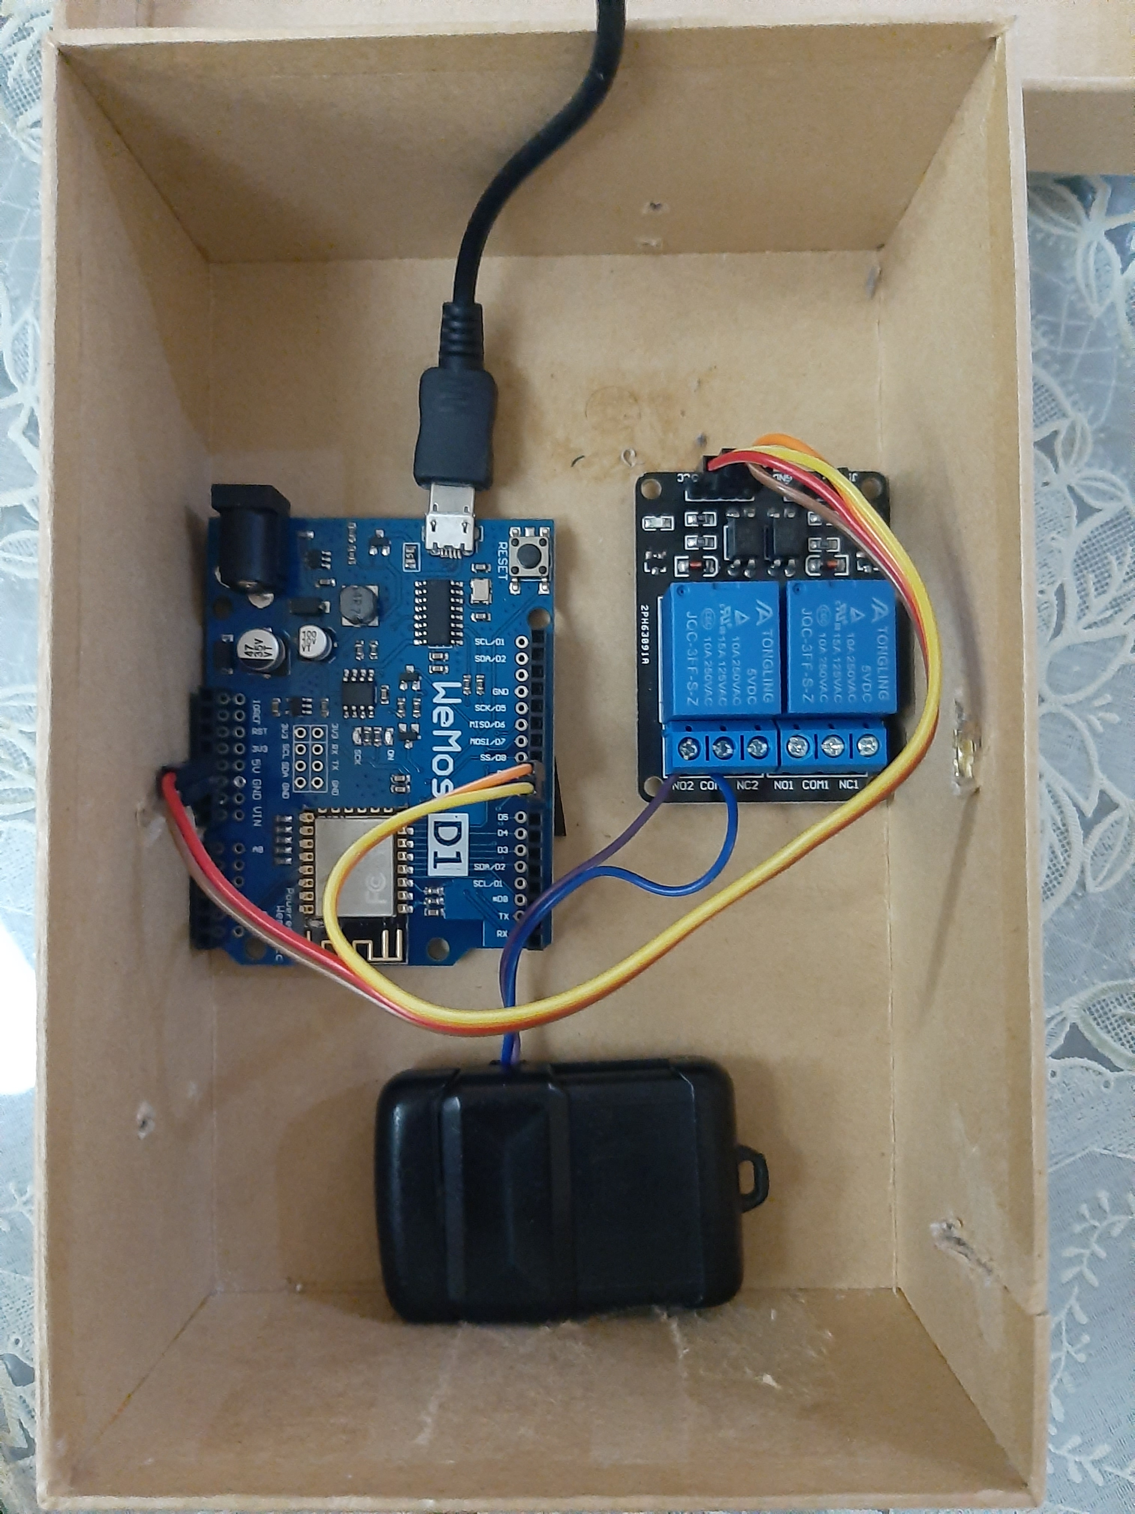
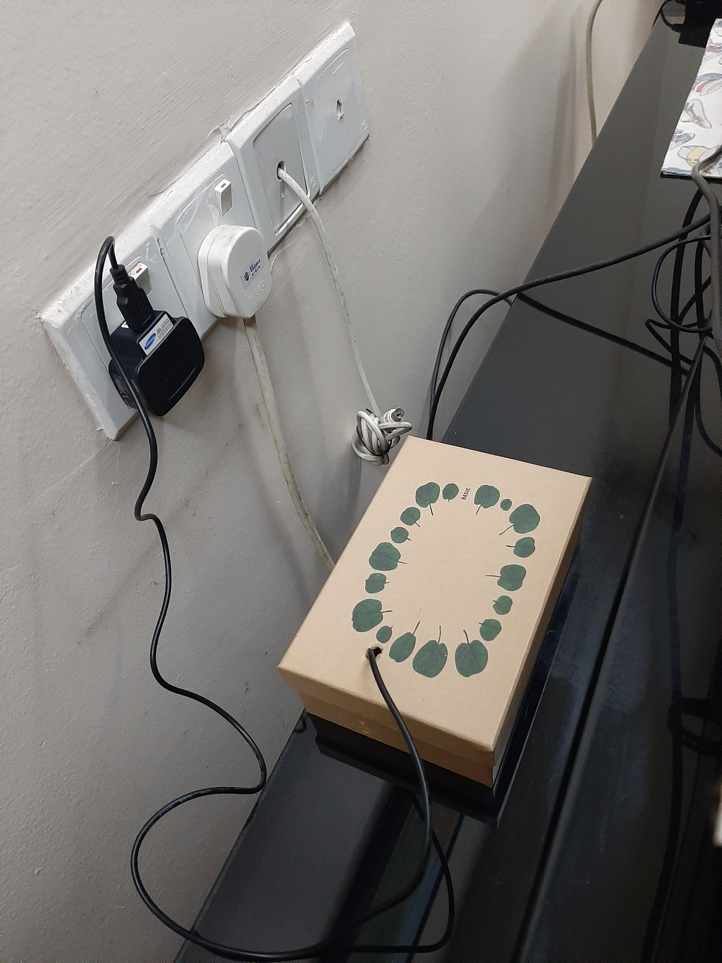
Hardware to control AutoGate

